Slide 1
What to talk about
- What models are we using
- why? Niv et al., 2012 for risk sensitive difference learning
- how well do they recover in predator and prey simulations (show plots)
- I’m running it with 83 simulations, which mimics the sample size I have with the hormone dataset
- how well are they identified with respect to each other? (show confusion matrix)
- How did we estimate the priors
- fixed effect across first decisions of many subjects (all datasets)
- How well do the models with the parameters recovered from real data predict actual behavior?
- plot expected offer against actual offers
- plot different learning outcomes of several subjects
- Start analyzing the behavioral, neural, and hormonal data with the parameters!

Slide 2
Why?
Individuals often act cooperatively even when the alternative is more personally profitable
Examples, people also fight each other all the damn time
Also interesting, in every day situations, we need to constantly interact with anonymous others. Predicting the behavior of these others is difficult, yet we do employ heuristics in order to accomplish this.
Perhaps one way that we acquire these heuristics is by learning an optimal distribution of behaviors that fits in certain situations.
Maybe our paradigm allows us to address this

Slide 3
The Predator Prey Game
Two-player, one-shot design
Rules
Each player starts with €10
If the prey invests as much or more than the predator, both keep their remaining endowment
If the predator invests more than the prey, predator adds preys remainder to his own remainder.
Prey survives
Predator kills
Predator
Endowment = €10
Investment = €3
Payout
10-3 = €7
Prey
Endowment = €10
Investment = €4
Payout
10-4 = €6
Predator
Endowment = €10
Investment = €5
Payout
10-5+(10-4) = €11
Prey
Endowment = €10
Investment = €4
Payout
€0

Slide 4
What do our subjects do?
Behavioral plots (simple barplots)
Predators invest lower than prey
Predators invest much less frequently than prey
In hormone dataset (maybe in both)
Previous reward impacts current trial, and this is more pronounced in prey than in predators

Slide 5
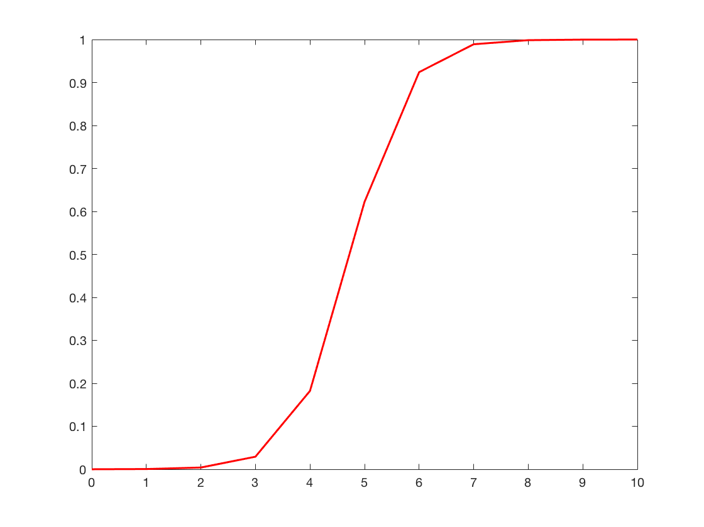
What could subjects be doing?
We submit that subjects are attempting to learn an optimal behavior from a noisy environment!
And how could they be doing this?
Not through simple Q-learning, that is too cumbersome and we believe psychologically unlikely
Specifically, we assume that a participant (P) learns a rival’s (R) acceptance logistic function 𝝋, which maps the investment amount into a victory or a defeat. This function is governed by two parameters, an intercept 𝝋_{R0} and a slope 𝝋_{R1}.
𝝋_{𝜷R1}
Probability of success
𝝋_{𝜷R0}
Investment

Slide 6
At each trial 𝒕, from his/her endowment 𝑬_{𝒕}, 𝑷 has to consider each possible offer 𝑨_{𝒕} and compute the expected payoff 𝑽_{𝒕}. This expected payoff depends on his/her estimate of how likely it is that 𝑨_{𝒕} will result in a victory: 𝑷_{𝑹,𝒕} (𝑫_{𝒕} = 𝟏|𝑨_{𝒕}). This will occur if R’s investment I_{t} is lower than 𝑨_{𝒕} in the case of predators and lower than or equal to 𝑨_{𝒕} in the case of prey. For simplicity, this will be referred to as 𝑷_{𝑹,𝒕}(𝑨_{𝒕}). 𝑷’s expected payoff 𝑽_{𝒕} for the offer 𝑨_{𝒕} is:
𝑽_{𝒕}=[P_{𝑹,𝒕}(𝑨_{𝒕})×(𝑬_{𝒕}−𝑨_{𝒕})]+[(𝟏–𝑷_{𝑹,𝒕}(𝑨_{𝒕}))×𝟎] if P is prey. (1)
𝑽_{𝒕}=[(P_{𝑹,𝒕}(𝑨_{𝒕})×(E_{𝒕}− I_{𝒕}))+(𝑬_{𝒕}−𝑨_{𝒕})]+[(𝟏–𝑷_{𝑹,𝒕}(𝑨_{𝒕}))×(𝑬_{𝒕}−𝑨_{𝒕})] if P is predator (2)
With the two square brackets representing cases where 𝑨_{𝒕} is above (or equal to) or below I_{t}, respectively.
Critically, 𝑷 estimates 𝑷_{𝑹,𝒕}(𝑨_{𝒕}) by estimating 𝑹’s acceptance logistic function 𝝋. Specifically, P forms a representation ϑ of R’s acceptance function 𝝋 by forming estimates 𝜷_{𝑹𝟎} and 𝜷_{𝑹1} of 𝝋‘s intercept and slope, respectively.
𝑷_{𝑹,𝒕}(𝑨_{𝒕})=𝟏/(𝟏+𝒆𝒙𝒑(−(𝜷_{𝑹𝟎,𝒕}+𝜷_{𝑹𝟏,𝒕}×𝑨_{𝒕}))) (3)

Slide 7

𝑷 can choose 𝑨_{𝒕} according to a softmax function (multinomial), with a temperature parameter 𝜷
P(A_{t} = i) = $\frac{eβ×V_{I}}{\sum_{j=1}^{n}{β×V_{I}}}$ (3)
Learning can be done using a simple delta rule on ϑ’s two parameters 𝜷_{𝑹𝟎,𝒕} and 𝜷_{𝑹𝟏,𝒕}. This means that P first computes a choice prediction error 𝜹_{C𝒕}
𝜹_{C𝒕} = 𝑫_{𝒕}−𝑷_{𝑹,𝒕}(𝑨_{𝒕}) (4)

Slide 8
This choice prediction error can then be used to update the parameters for the next trial using a Rescorla-Wagner update function . For simplicity, we assume that 𝜷_{𝑹𝟏} will remain constant, while 𝜷_{𝑹𝟎} will be updated on each trial. We propose four different iterations of an update procedure that P can conceivably utilize in order to learn 𝝋.
Case 1: P updates his/her 𝛃_{R0} at time t using the choice prediction error δ_{Ct} and a single learning rate α. Specifically, if δ_{Ct} is positive you increase 𝛃_{R0} (meaning P lowers the investment value necessary for victory), and if δ_{Ct} is negative P decreases 𝛃_{R0} (meaning P raises the investment value necessary for victory – recall that increasing the intercept shifts the entire logit function to the right and hence lowers the expected probability of success for each investment):
𝛃_{R0,t+1}=𝛃_{R0,t}+α× δ_{Ct} (5)

Slide 9
Case 2: P updates his/her 𝛃_{R0} at time t using the choice prediction error δ_{Ct} and two learning rates: α⁺ for positive prediction errors, and α⁻ for a negative prediction errors:
𝛽_{R0,t+1}=𝛽_{R0,t}+α⁺× δ_{Ct} if δ_{Ct} > 0 (6)
𝛽_{R0,t+1}=𝛽_{R0,t}+α⁻× δ_{Ct} if δ_{Ct} < 0
Case 3: P updates his/her 𝛃_{R0} at time t using the reward prediction error δ_{R} and a single learning rate α. The calculation of δ_{R} is accomplished by subtracting the actual reward from the expected reward and is equivalent to the following expressions (see supplementary slides for full derivations of these equations):
δ_{Rt} = δ_{Ct} × (𝑬_{𝒕}−𝑨_{𝒕}) if subject is prey (7)
δ_{Rt} = δ_{Ct} × (I_{t} −𝑨_{𝒕}) if subject is predator (8)

Slide 10
δ_{Rt} is then used by P to update ϑ in the same way δ_{Ct} was used in cases 1 and 2:
𝛃_{R0,t+1}=𝛃_{R0,t}+α× δ_{Rt} (9)
Case 4: P updates his/her 𝛃_{R0} at time t using the reward prediction error δ_{Rt} and two learning rates: α⁺ for positive prediction errors, and α⁻ for a negative prediction errors:
𝛽_{R0,t+1}=𝛽_{R0,t}+α⁺× δ_{Rt} if δ_{Ct} > 0 (10)
𝛽_{R0,t+1}=𝛽_{R0,t}+α⁻× δ_{Rt} if δ_{Ct} < 0

Slide 11
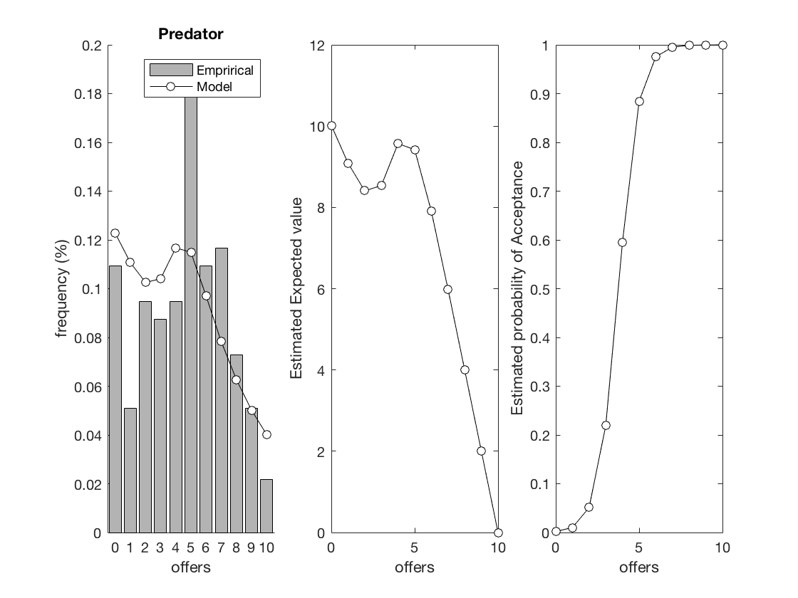
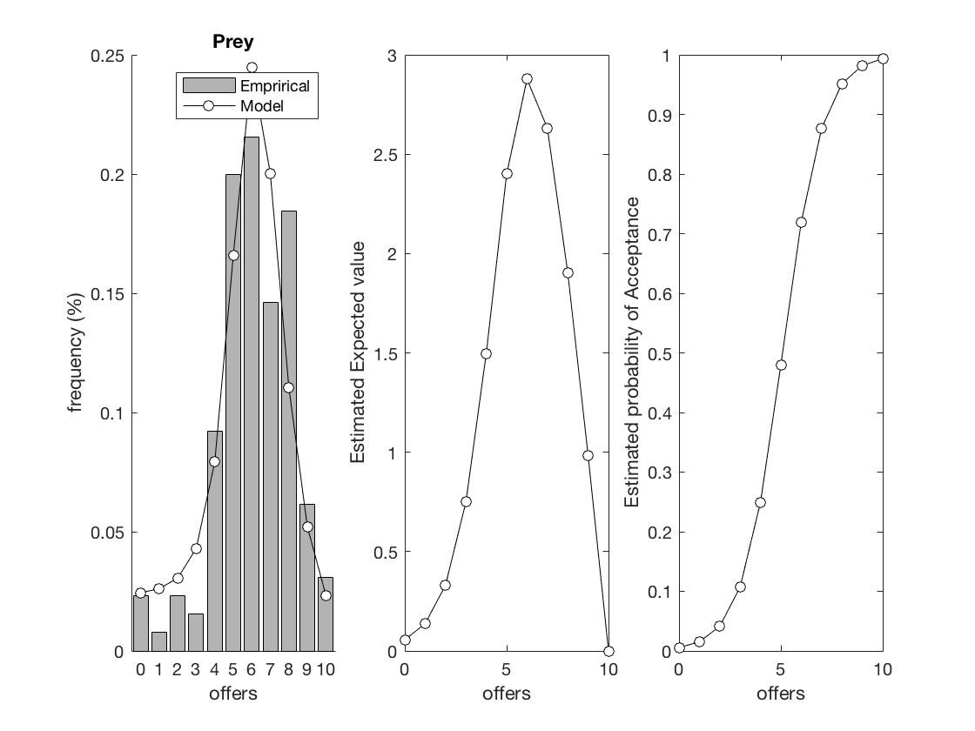
Empirical Priors
Importantly, to avoid fitting additional free parameters, the model requires initial estimates of 𝜷_{𝑹𝟎} and 𝜷_{𝑹𝟏}.
We estimated these as fixed effects from the first investments made by subjects playing the game for the first time. We used data from several datasets, amounting to a total of 267 subjects, 130 player as prey and 137 playing as predator*. Importantly, we constrained the parameters using a Laplace procedure, allowing us to stay away from the bounds of the parameter space.
* Prey: 12 (old_hor) + 81 (hor) + 25 (ital) + 12 (OT)
Predator: 12 (old_hor) + 85 (hor) + 25 (ital) + 15 (OT) the parameters and accompanying plots were produced by PPG/empirical_priors_mg_predprey_2017_10_03.m

Slide 12
Simulations
We ran simulations in order to test for (i) model recoverability and (ii) model identifiability.
Importantly, we ran simulations that approximated the parameters of each experiment to which we want to fit our models. These include the following:
Experiment 1: within subject design; 27 subjects played both roles in blocks of 20 trials for 1 session, total of 60 trials in fMRI machine.
Experiment 2: within subject design; 24 subjects played both roles in blocks of 60 over two sessions, total of 120 trials in behavior lab (hormone study)
Experiment 3: between subject design; 50 subjects played in one role for one block of 60 trials, total of 60 trials (hormone study)
Experiment 4: between subject design; 166 subjects played in one role for one block of 60 trials, total of 60 trials per subject (hormone study)

Slide 13
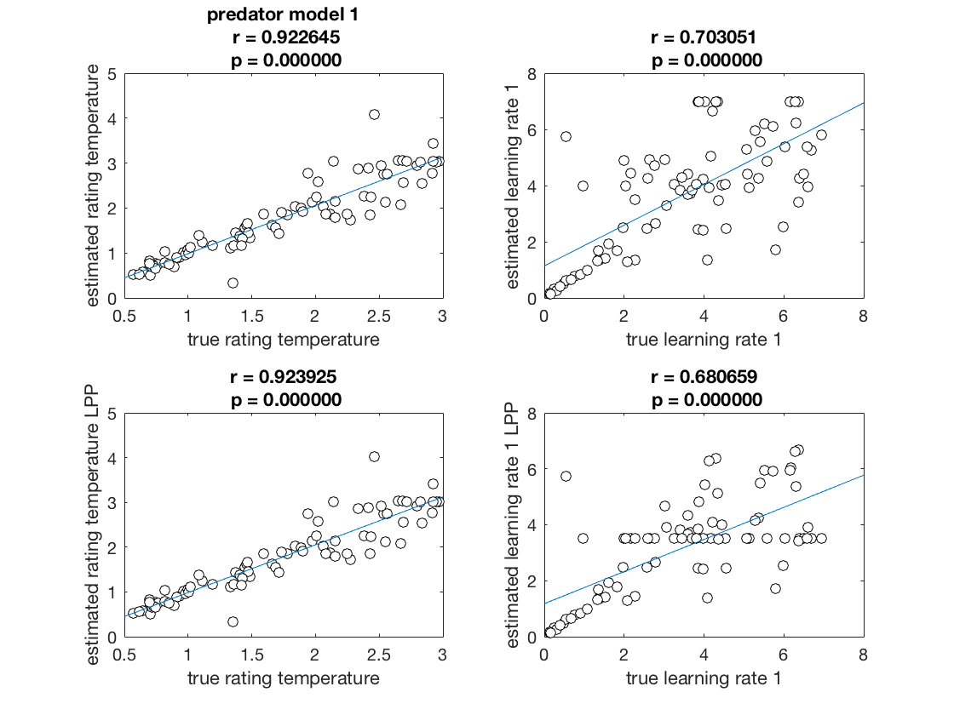
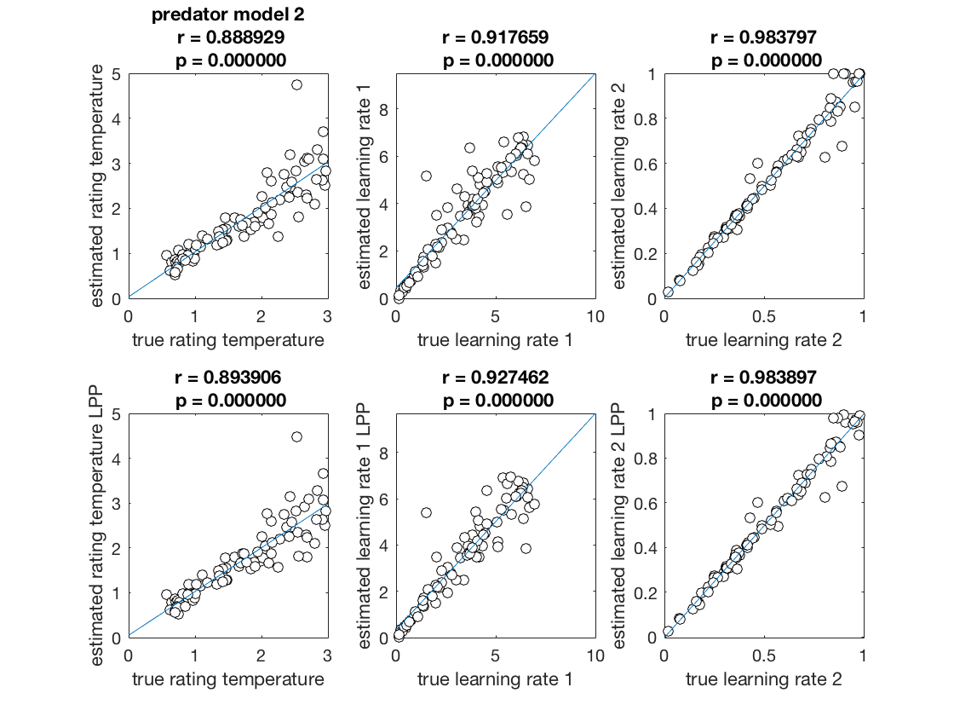
Simulations: Experiment 4 Recovery for Predators
166 subjects simulated for cases 1 and 2. For each simulation, model parameters were randomly selected. Models were then fit to data generated from those simulations. These plots show correlations between the parameters recovered from the fitting process and the true parameters used to generate the data
from PPG/test_recovery_models_MG_2017_09_21.m
Top row represents unconstrained parameter estimation, bottom row represents Laplace constrained. Columns 1 and 2 represent parameters for case 1, columns 3-5 represent parameters from case 2.

Slide 14
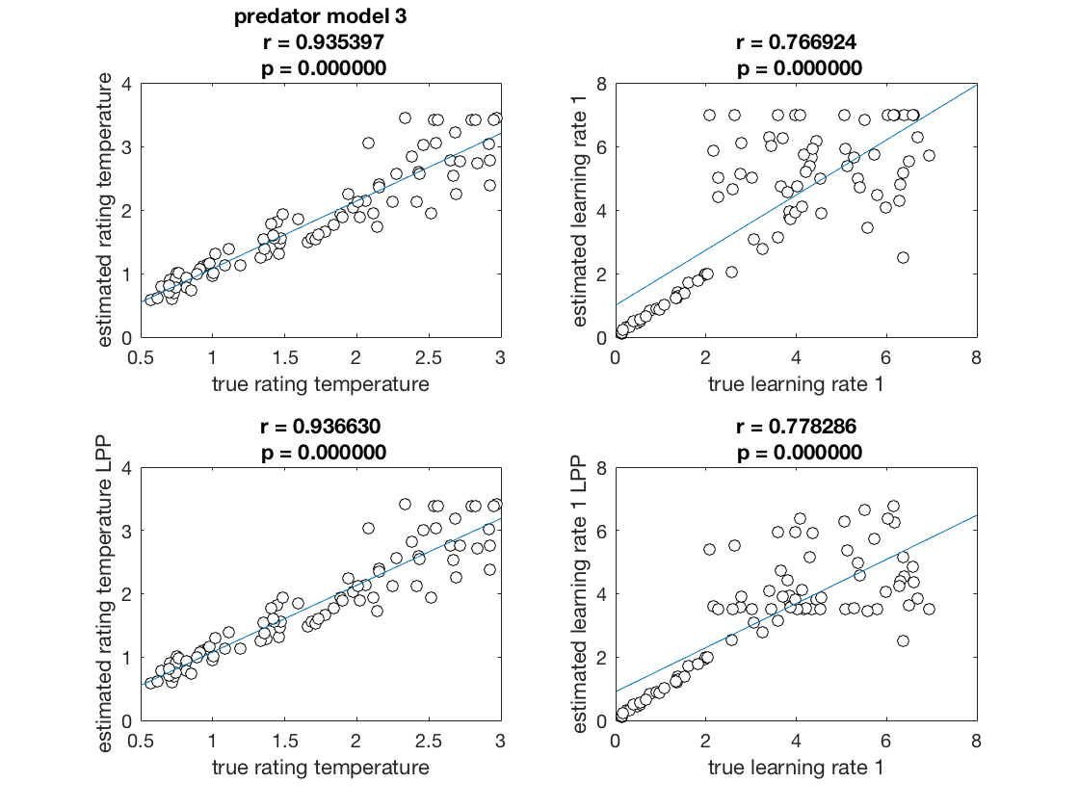
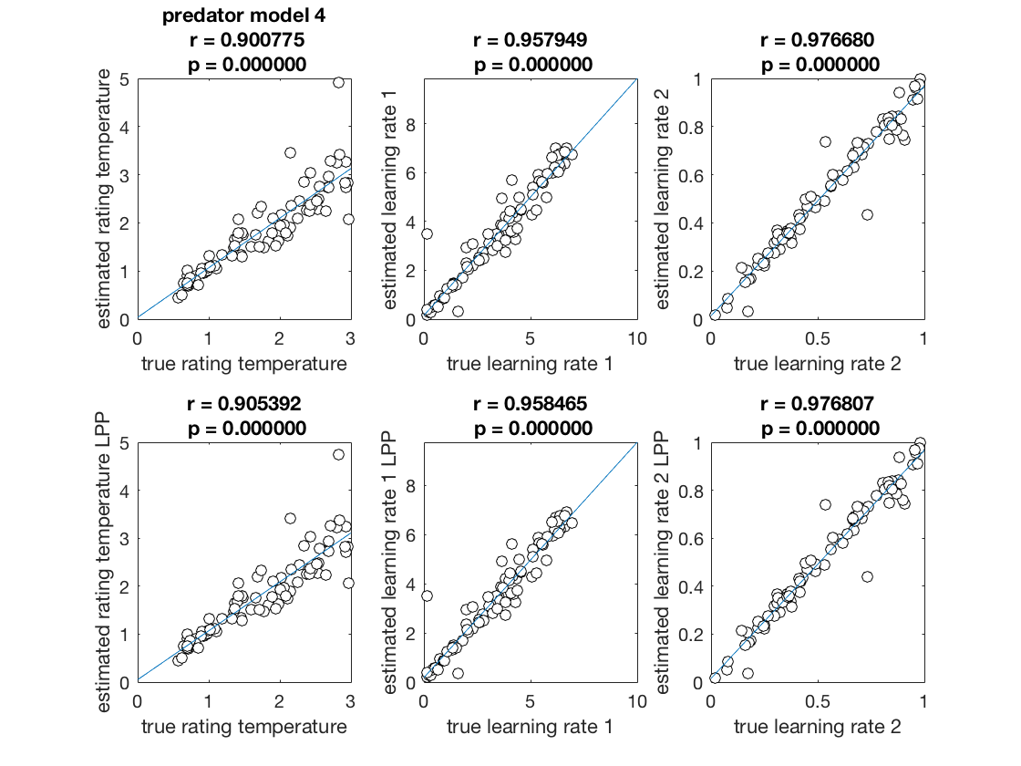
Simulations: Experiment 4 Recovery for Predators
166 subjects simulated for cases 3 and 4. For each simulation, model parameters were randomly selected. Models were then fit to data generated from those simulations. These plots show correlations between the parameters recovered from the fitting process and the true parameters used to generate the data
Top row represents unconstrained parameter estimation, bottom row represents Laplace constrained. Columns 1 and 2 represent parameters for case 1, columns 3-5 represent parameters from case 2.

Slide 15
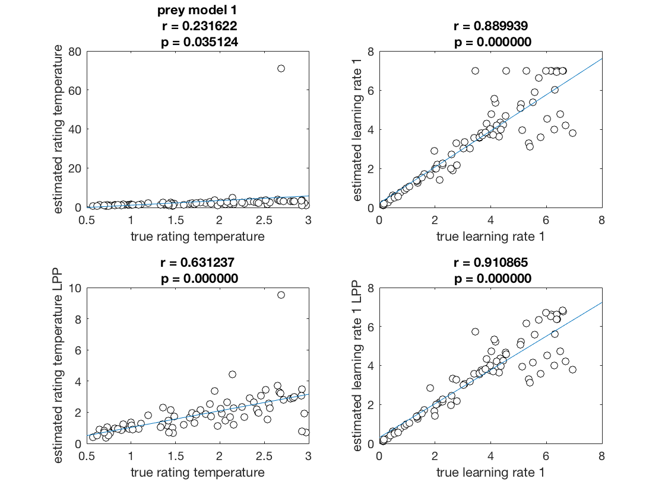
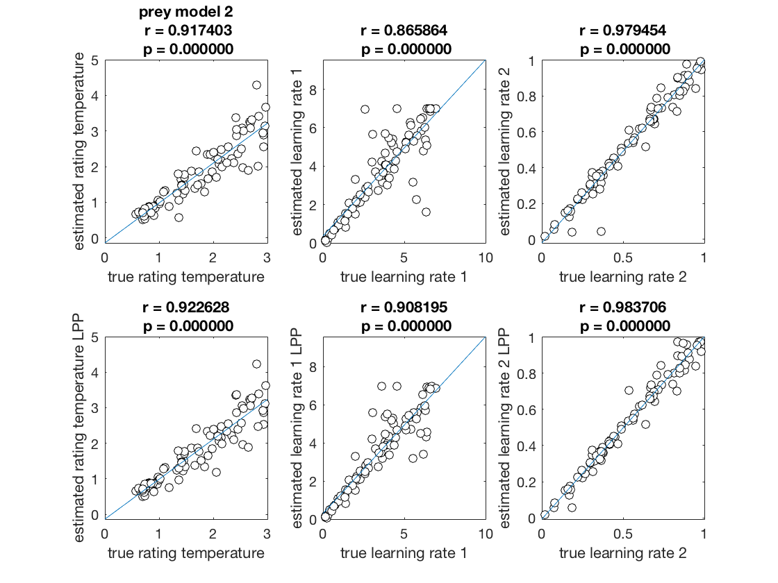
Simulations: Experiment 4 Recovery for Prey
166 subjects simulated for cases 1 and 2. For each simulation, model parameters were randomly selected. Models were then fit to data generated from those simulations. These plots show correlations between the parameters recovered from the fitting process and the true parameters used to generate the data
Top row represents unconstrained parameter estimation, bottom row represents Laplace constrained. Columns 1 and 2 represent parameters for case 1, columns 3-5 represent parameters from case 2.

Slide 16
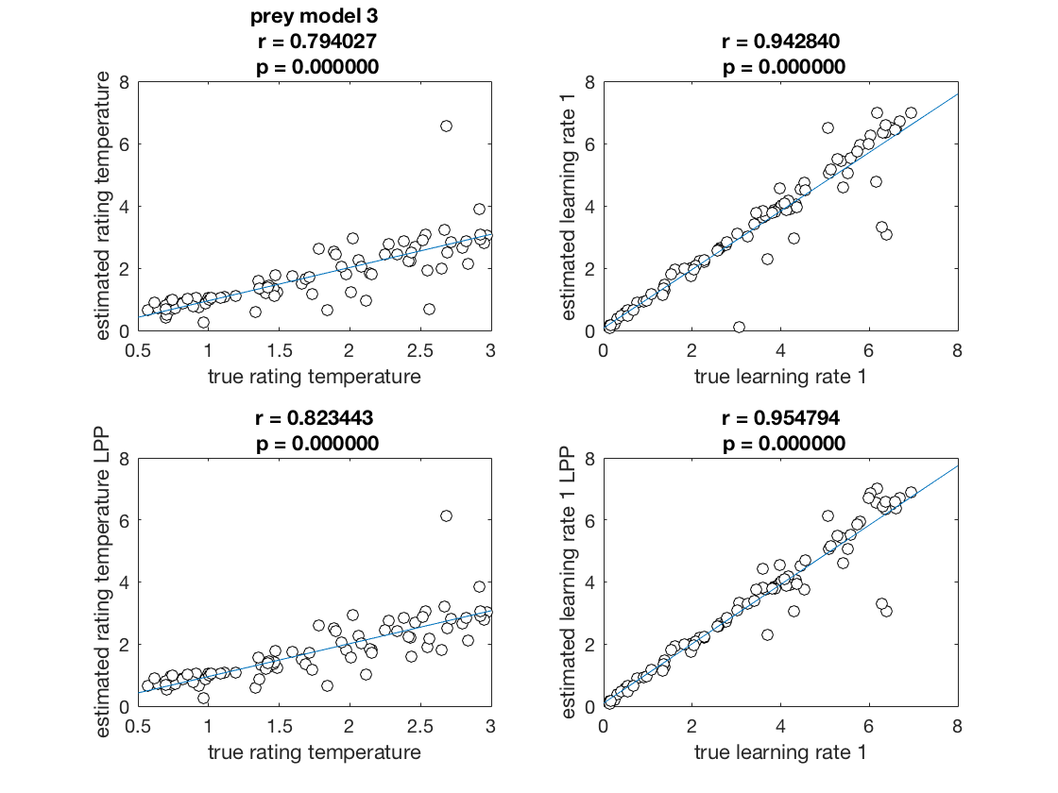
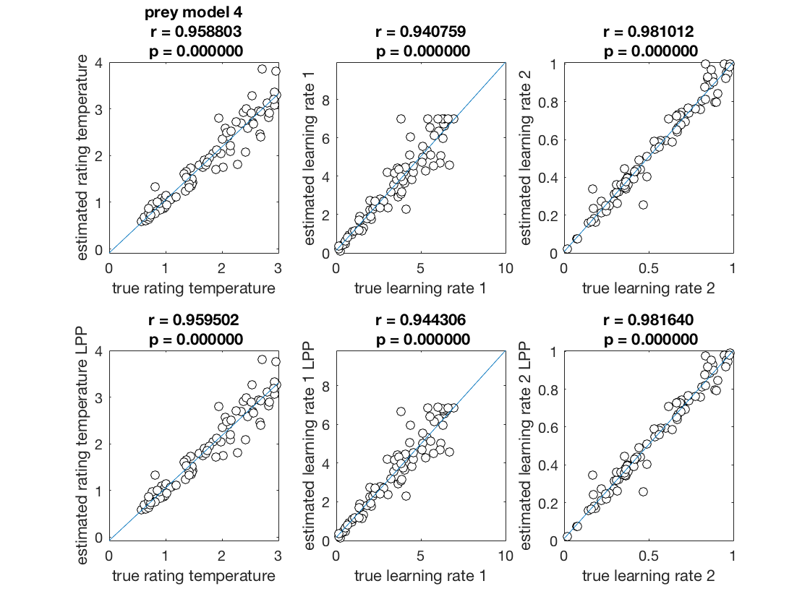
Simulations: Experiment 4 Recovery for Prey
166 subjects simulated for cases 3 and 4. For each simulation, model parameters were randomly selected. Models were then fit to data generated from those simulations. These plots show correlations between the parameters recovered from the fitting process and the true parameters used to generate the data
Top row represents unconstrained parameter estimation, bottom row represents Laplace constrained estimation. Columns 1 and 2 represent parameters for case 3, columns 3-5 represent parameters from case 4.

Slide 17
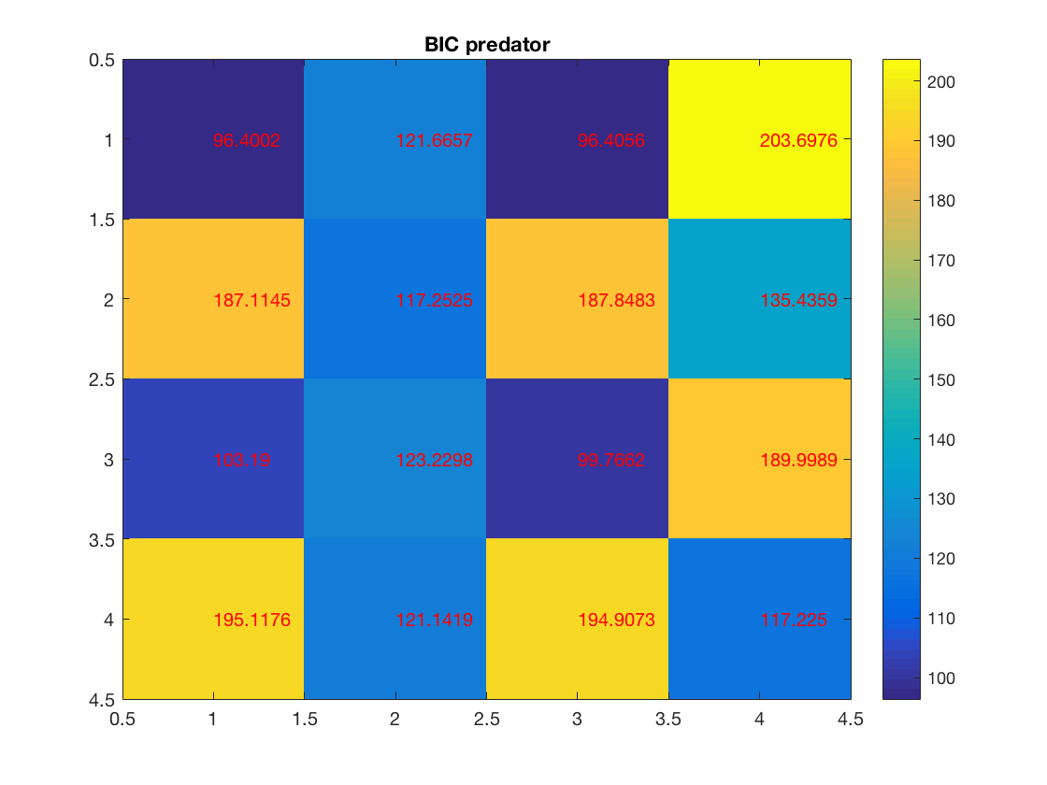
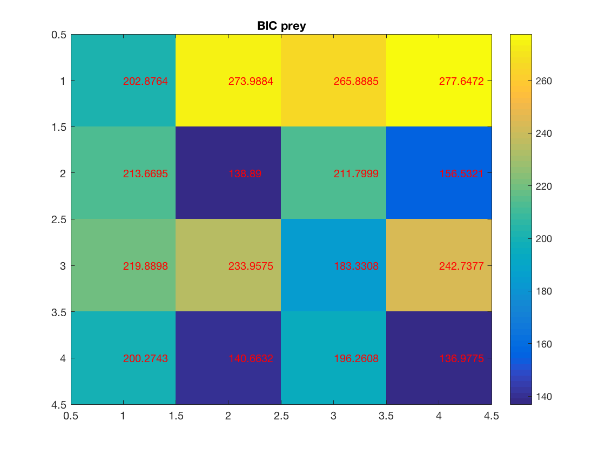
Simulations: Experiment 4 Model Identifiability: Confusion Matrices
Confusion matrices. Each row represents the model that was used to simulate the data (cases 1-4), and each column represents the model that was used to fit the data. Lower Bayesian information criterion (BIC) indicates a better fit of the model to the data. Therefore, for optimal model identifiability, we would hope for a dark diagonal, and white everywhere else. While this is not the case with these models, in almost every case, the model used the generate the data does yield the lowest BIC when used to fit the data. In other words, while the models do appear to be identifiable, we should interpret BIC’s near one another with caution.

Slide 18
Simulations summary
As can be seen from figures 1-

Slide 20
Supplementary Material
Reward prediction error: δ_{R}
Case 3: P updates his/her 𝛃_{R0} at time t using the reward prediction error δ_{R} and a single learning rate α. The calculation of δ_{R} is accomplished by subtracting the actual reward M:
M_{t} = 𝑫_{𝒕}×(𝑬_{𝒕}−𝑨_{𝒕}) if P is prey (S1)
M_{t} = (𝑬_{𝒕}−𝑨_{𝒕}) + (𝑫_{𝒕}×(I_{t} −𝑨_{𝒕})) if P is predator (S2)
from the expected reward V_{t} (recall equations 1 and 2):
𝑽_{𝒕}=[P_{𝑹,𝒕}(𝑨_{𝒕})×(𝑬_{𝒕}−𝑨_{𝒕})]+[(𝟏–𝑷_{𝑹,𝒕}(𝑨_{𝒕}))×𝟎] if P is prey. (1)
𝑽_{𝒕}=[(P_{𝑹,𝒕}(𝑨_{𝒕})×(E_{𝒕}− I_{𝒕}))+(𝑬_{𝒕}−𝑨_{𝒕})]+[(𝟏–𝑷_{𝑹,𝒕}(𝑨_{𝒕}))×(𝑬_{𝒕}−𝑨_{𝒕})] if P is predator (2)

Slide 21
Supplementary Material
Therefore, reward prediction error δ_{Rt} is calculated as follows if P is prey:
δ_{Rt} = [𝑫_{𝒕}×(𝑬_{𝒕}−𝑨_{𝒕})] - [P_{𝑹,𝒕}(𝑨_{𝒕})×(𝑬_{𝒕}−𝑨_{𝒕})]+[(𝟏–𝑷_{𝑹,𝒕}(𝑨_{𝒕}))×𝟎]
δ_{Rt} = [𝑫_{𝒕}×(𝑬_{𝒕}−𝑨_{𝒕})] - [P_{𝑹,𝒕}(𝑨_{𝒕})×(𝑬_{𝒕}−𝑨_{𝒕})]
Which is equivalent to
δ_{Rt} = (𝑫_{𝒕} - P_{𝑹,𝒕}(𝑨_{𝒕})) × (𝑬_{𝒕}−𝑨_{𝒕})
Recall equation 4:
𝜹_{C𝒕} = 𝑫_{𝒕}−𝑷_{𝑹,𝒕}(𝑨_{𝒕}) (4)

Slide 22
Supplementary Material
Therefore, reward prediction error simplifies to:
δ_{Rt} = δ_{Ct} × (𝑬_{𝒕}−𝑨_{𝒕}) if subject is prey (S3)
For predators, recall equation S2:
M_{t} = (𝑬_{𝒕}−𝑨_{𝒕}) + (𝑫_{𝒕}×(I_{t} −𝑨_{𝒕})) if P is predator (S2)
And equation 2:
𝑽_{𝒕}=[(P_{𝑹,𝒕}(𝑨_{𝒕})×(E_{𝒕}− I_{𝒕}))+(𝑬_{𝒕}−𝑨_{𝒕})]+[(𝟏–𝑷_{𝑹,𝒕}(𝑨_{𝒕}))×(𝑬_{𝒕}−𝑨_{𝒕})] if P is predator (2)

Slide 23
Supplementary Material
Therefore, reward prediction error δ_{Rt} is calculated as follows if P is predator:
δ_{Rt} = [(𝑫_{𝒕}×(I_{𝒕}−𝑨_{𝒕})) + (𝑬_{𝒕}−𝑨_{𝒕})] - [(P_{𝑹,𝒕}(𝑨_{𝒕})×(I_{𝒕}−𝑨_{𝒕})) + (𝑬_{𝒕}−𝑨_{𝒕})]
δ_{Rt} = [𝑫_{𝒕}×(I_{𝒕}−𝑨_{𝒕})] - [P_{𝑹,𝒕}(𝑨_{𝒕})×(I_{𝒕}−𝑨_{𝒕})]
Which is equivalent to
δ_{Rt} = (𝑫_{𝒕} - P_{𝑹,𝒕}(𝑨_{𝒕})) × (I_{𝒕}−𝑨_{𝒕})
Ergo:
δ_{Rt} = δ_{Ct} × (I_{t} −𝑨_{𝒕}) if subject is predator (S4)

